Slide 1
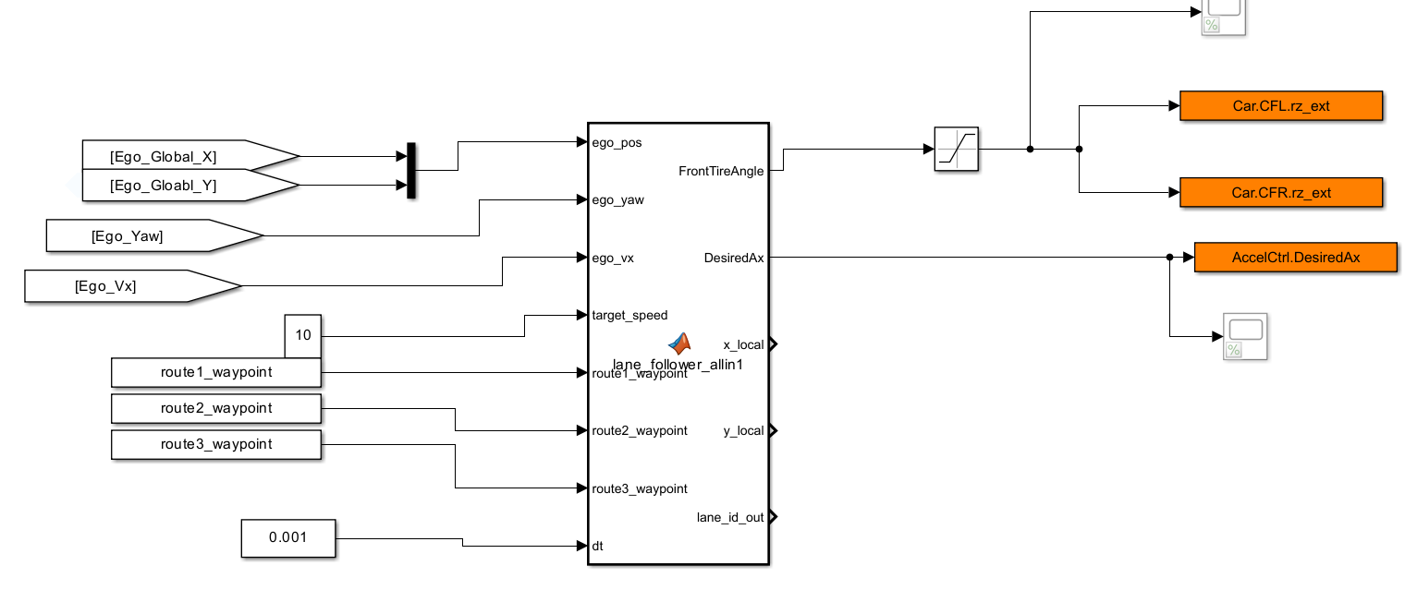

Slide 2
%%
function [FrontTireAngle, DesiredAx, x_local, y_local, lane_id_out] = lane_follower_allin1( ...
ego_pos, ego_yaw, ego_vx, target_speed, ...
route1_waypoint, route2_waypoint, route3_waypoint, dt)
% 하나의 블록에서 10초마다 차선 바꾸면서 해당 차선 추종
%% 1. 10초 주기 lane_id 변경 (시퀀스)
persistent elapsed lane_idx
seq = [1 2 1]; % 순환 패턴
Nseq = length(seq);
T = 15; % 15초
if isempty(elapsed)
elapsed = 0;
lane_idx = 1;
end
elapsed = elapsed + dt;
if elapsed >= T
lane_idx = mod(lane_idx, Nseq) + 1;
elapsed = 0;
end
lane_id = seq(lane_idx);
lane_id_out = lane_id; % (디버깅/Scope 출력용)
%% 2. 차선별 route 선택
if lane_id == 1
waypoints = route1_waypoint;
elseif lane_id == 2
waypoints = route2_waypoint;
elseif lane_id == 3
waypoints = route3_waypoint;
else
waypoints = route1_waypoint; % 예외
end
%% 3. 웨이포인트 추종 로직
ego_x = ego_pos(1);
ego_y = ego_pos(2);
% 샘플링
sample_gap = 10;
x = waypoints(1:sample_gap:end,1);
y = waypoints(1:sample_gap:end,2);
% 이상치 필터링
dx = diff(x); dy = diff(y);
d = sqrt(dx.^2 + dy.^2);
thresh = mean(d) + 4*std(d);
normal_idx = find([true; d < thresh]);
x_filt = x(normal_idx);
y_filt = y(normal_idx);
% 폐곡선 보장
if norm([x_filt(1), y_filt(1)] - [x_filt(end), y_filt(end)]) > 1e-3
x_filt = [x_filt; x_filt(1)];
y_filt = [y_filt; y_filt(1)];
end
N = length(x_filt);
% 보간
interp_ratio = 3;
max_interp = min(10000, interp_ratio*N);
t = (1:N)';
tq = linspace(1, N, max_interp)';
route_xq = interp1(t, x_filt, tq, 'spline');
route_yq = interp1(t, y_filt, tq, 'spline');
Nq = length(route_xq);
% 윈도우/인덱스 관리
persistent prev_idx
if isempty(prev_idx)
dist_init = sqrt((route_xq - ego_x).^2 + (route_yq - ego_y).^2);
[~, prev_idx] = min(dist_init);
end
window_size = 300;
idx_win = mod((prev_idx-window_size):(prev_idx+window_size)-1, Nq) + 1;
dx_win = route_xq(idx_win) - ego_x;
dy_win = route_yq(idx_win) - ego_y;
x_local_win = dx_win * cos(-ego_yaw) - dy_win * sin(-ego_yaw);
y_local_win = dx_win * sin(-ego_yaw) + dy_win * cos(-ego_yaw);
% 진행방향(dot product) 기반 추종점 선택
Nw = length(idx_win);
tangent_vecs = zeros(Nw,2);
for i=1:Nw
ip1 = mod(idx_win(i), Nq) + 1;
tangent_vecs(i,1) = route_xq(ip1) - route_xq(idx_win(i));
tangent_vecs(i,2) = route_yq(ip1) - route_yq(idx_win(i));
end
tangent_norm = sqrt(sum(tangent_vecs.^2,2));
tangent_vecs = tangent_vecs ./ max(tangent_norm, 1e-6);
ego_heading = [cos(ego_yaw), sin(ego_yaw)];
dotval = tangent_vecs * ego_heading';
valid_idx = find(x_local_win > 0 & dotval > 0.0);
if isempty(valid_idx)
[~, idx_sub] = min(sqrt(dx_win.^2 + dy_win.^2));
idx_min = idx_win(idx_sub);
idx_local = idx_sub;
else
[~, idx_sub] = min(x_local_win(valid_idx).^2 + y_local_win(valid_idx).^2);
idx_min = idx_win(valid_idx(idx_sub));
idx_local = valid_idx(idx_sub);
end
x_local = x_local_win(idx_local);
y_local = y_local_win(idx_local);
cte = y_local;
prev_idx = mod(idx_min - 1, Nq) + 1;
% --- 횡방향 PD 제어 (조향) + 제한 ---
persistent prev_e prev_steer
if isempty(prev_e)
prev_e = 0;
end
if isempty(prev_steer)
prev_steer = 0;
end
Kp = 0.04;
Kd = 0.04;
d_e = (cte - prev_e) / dt;
raw_steer = (Kp * cte + Kd * d_e);
prev_e = cte;
% 조향각 제한
STEER_LIMIT = 0.7;
raw_steer = max(min(raw_steer, STEER_LIMIT), -STEER_LIMIT);
% 조향각 변화율 제한
MAX_STEER_RATE = 0.015;
delta_steer = raw_steer - prev_steer;
delta_steer = max(min(delta_steer, MAX_STEER_RATE), -MAX_STEER_RATE);
FrontTireAngle = prev_steer + delta_steer;
prev_steer = FrontTireAngle;
% --- 종방향 PID 제어 (속도/가속) ---
vel_error = target_speed - ego_vx;
persistent int_v prev_v
if isempty(int_v)
int_v = 0;
prev_v = 0;
end
Kp_v = 1.2;
Ki_v = 0.2;
Kd_v = 0.05;
int_v = int_v + vel_error * dt;
d_v = (vel_error - prev_v) / dt;
DesiredAx = Kp_v * vel_error + Ki_v * int_v + Kd_v * d_v;
prev_v = vel_error;
% --- 자차 속도 제한 ---
MAX_SPEED = 15;
if ego_vx >= MAX_SPEED && target_speed >= MAX_SPEED
DesiredAx = min(DesiredAx, 0);
end
% --- 조향각에 따라 가속 억제 ---
STEER_THRES = 0.12; % [rad] (약 7도)
if abs(FrontTireAngle) > STEER_THRES
DesiredAx = min(DesiredAx, 0); % 감속 또는 유지만 허용
end
end

